Slide 1

heart disease and cancer Prediction Using Supervised Machine Learning Techniques
Nipun Rishi (PIET16CE070) Guide Name : Dr. Rekha Jain
Nitesh Sachdev (PIET16CE074)
Yash Mathur(PIET16CE121)

Slide 2
Abstract:
Heart Disease is a common problem which can be quite severe in old ages and also in people who don’t live a healthy lifestyle. People should go for a regular check up and diagnosis in addition to maintain a decent eating habit can prevent it to some extent.
Breast cancer represents one of the diseases that make a high number of deaths every year. It is the most common type of all cancers and the main cause of women's deaths worldwide.
As the diagnosis of this disease manually takes long hours and the lesser availability of systems, there is a need to develop the automatic diagnosis system for early detection of cancer.
Now-a-days, the Healthcare industry faces a major challenge i.e. superiority of facility. Quality of service is defined as how correctly the disease is diagnosed and how effective the treatment is given to the patients. Poor diagnosis could cause disastrous consequences that are not acceptable

Slide 3
What is Machine Learning?
Machine learning is an application of artificial intelligence (AI) that provides systems the ability to automatically learn and improve from experience without being explicitly programmed.
Machine learning focuses on the development of computer programs that can access data and use it learn for themselves.
The primary aim is to allow the computers learn automatically without human intervention or assistance and adjust actions accordingly.
Some machine learning methods:
  Machine learning algorithms are often categorized as supervised or unsupervised.
  Supervised machine learning algorithms can apply what has been learned in the past to new data using labeled examples to predict future events.
  In contrast, unsupervised machine learning algorithms are used when the information used to train is neither classified nor labeled.

Slide 4
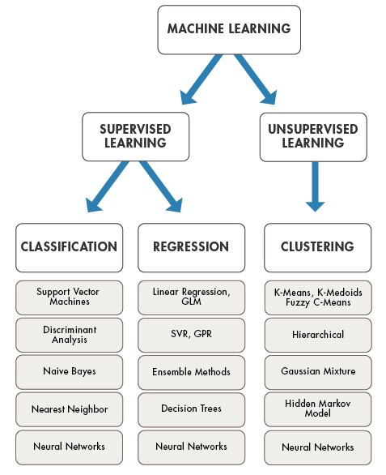
Machine learning algorithms

Slide 5

All of these JavaScript libraries and Framework together are used to make a single-page web app or mobile applications.
Such kind of applications are dynamic and used different kind of linking/routing to navigate between different pages which are present on the Web Application.
So indirectly if we say the Pages doesn’t change instead the Components are changed of the page. That’s why it is called a single page web app, since the changing of components and not the complete pages.

Slide 6
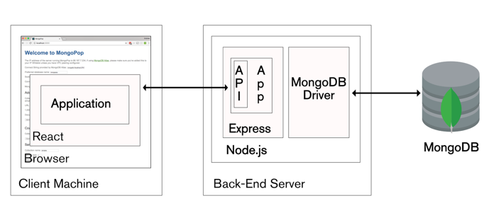
Architecture of The MERN Stack

Slide 7
technology stack:
Machine Learning using Python – Machine learning algorithms build a mathematical model based on sample data and it’s a subset of artificial intelligence.
MERN Stack – MERN is a free and open-source JavaScript software stack for building dynamic web sites and web applications
Python Flask Framework - This framework can bear the load of machine learning effectively.
Data Mining - For the graphical analysis of data and finding meaning pattern
Python libraries such as Pandas, NumPy, MatplotLib, beautifulsoup, etc
Script Language:- Python, Jinja, Node JS, HTML, CSS

Slide 8
Web application
MERN Stack
Mongo DB – Database on JSON format
Express JS – Server
React JS – Front-end Java Script Library
Node JS – Server Side Scripting

Slide 9
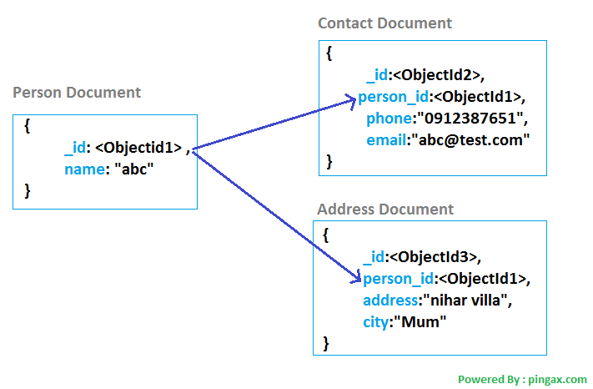
Structure of MongoDB
The data that is stored in the MongoDB is in JSON(Java Script Object Notation)
It is a NoSQL database
It has database which consists of collection of documents.

Slide 10

ReactJS
React JS is a JavaScript library for building user interfaces. It is maintained by Facebook and a community of individual developers and companies. React can be used as a base in the development of single-page or mobile applications, it is optimal for fetching rapidly changing data that needs to be recorded.
Main features:-
  Declarative : design different views for each state, which will be efficiently updated and re-rendered.
  Component-based: Build components, that manage their own state and structure them together into more complex UIs.
  Maintains an internal representation of the rendered UI, that only renders only the changed element.

Slide 11


Express JS & Node JS
They both together provide a robust set of features to develop web and mobile applications.
It allows user to set up middleware to respond to HTTP requests.
Defines a routing table which is used to perform different actions based on HTTP Method and URL.
Allows to dynamically render HTML pages based on passing of arguments to templates.

Slide 12
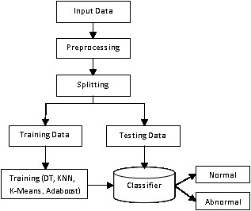
Strategy or approach to solve the problem:
Machine Learning & Data Mining Techniques are used to solve the problem.

Slide 13
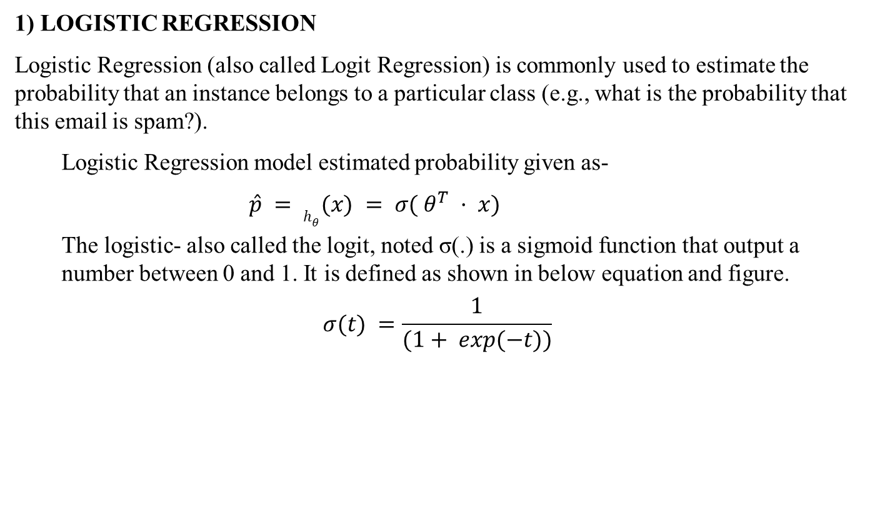
Model selection
1) LOGISTIC REGRESSION
Logistic Regression (also called Logit Regression) is commonly used to estimate the probability that an instance belongs to a particular class (e.g., what is the probability that this email is spam?).
Logistic Regression model estimated probability given as-
$\hat{p} = h_{θ}(x) = σ( θ^{T} · x)$
The logistic- also called the logit, noted σ(.) is a sigmoid function that output a number between 0 and 1. It is defined as shown in below equation and figure.
$$σ(t) =\frac{1}{(1+ exp(−t))}$$

Slide 14
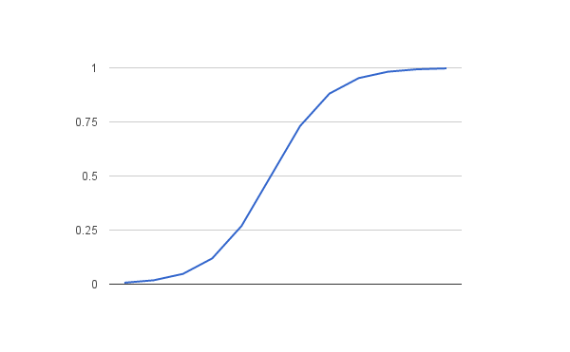
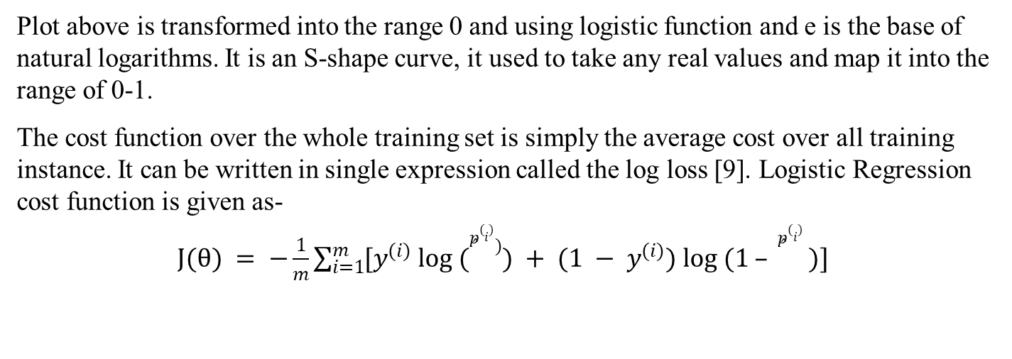
Plot above is transformed into the range 0 and using logistic function and e is the base of natural logarithms. It is an S-shape curve, it used to take any real values and map it into the range of 0-1.
The cost function over the whole training set is simply the average cost over all training instance. It can be written in single expression called the log loss [9]. Logistic Regression cost function is given as-
$J(θ) = −\frac{1}{m}\sum_{i=1}^{m}{[y^{(i)} log ({\hat{p}}^{(i)})) + (1 − y^{(i)}) log (1 – {\hat{p}}^{(i)} )]}$

Slide 15
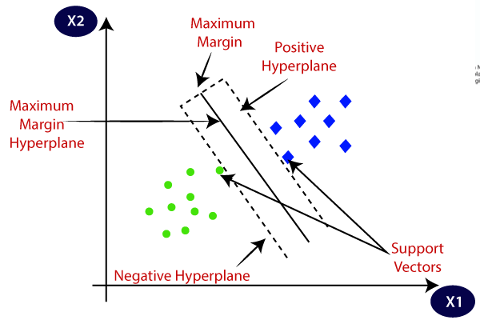
2) Support vector machine
SUPPORT VECTOR MACHINE (SVM)
Support Vector Machine (SVM) is quite versatile and most popular model in Supervised Learning algorithms, capable of performing linear or non-linear classification, regression and even outlier detection.
So that class of new dataset is easily identified by just putting in the plane. This best decision boundary is called as Hyper Plane, which does the work of separating the members into classes.
The equation of Hyper Plane is W^{T}X=0 which is similar to equation of straight line Y=aX+b, where W and X represent vector. Consider the below diagram in which there are two different categories that are classified using a decision boundary or hyperplane:

Slide 16
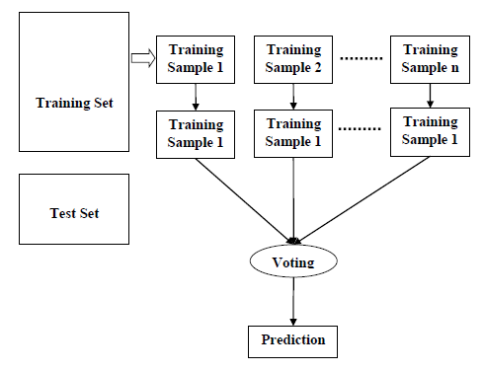
3)RAMDOM FOREST
Random Forest is one of the most powerful and popular machine learning algorithm. It is capable of performing both Classification and Regression task. It takes less training time a compares to other algorithm and give output at high accuracy, even for the large dataset it runs efficiently. It can also maintain accuracy when large proportion of data is missing.
We can understand the working of Random Forest algorithm with the following steps −
Step 1 – Assume number of cases in the training is N. Then, sample of these N cases is taken at random but with replacement.
Step 2 – If there are M input variable or features, a number m<M is specified such that at each node, m variable are selected at random out of the M. The best split on these m is used to split the node the value of m is held constant while we grow the forest.
Step 3 – Each tree is grown to the largest extent possible and there is no pruning.
Step 4 – Predict new data by aggregating the predictions of the n tree trees (i.e. majority votes for classification, average for regression).

Slide 17
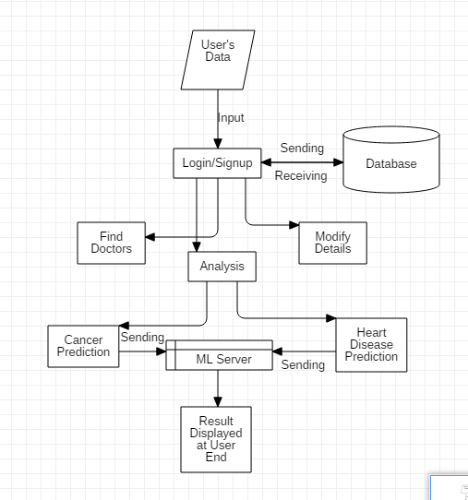
Working of our project

Slide 18
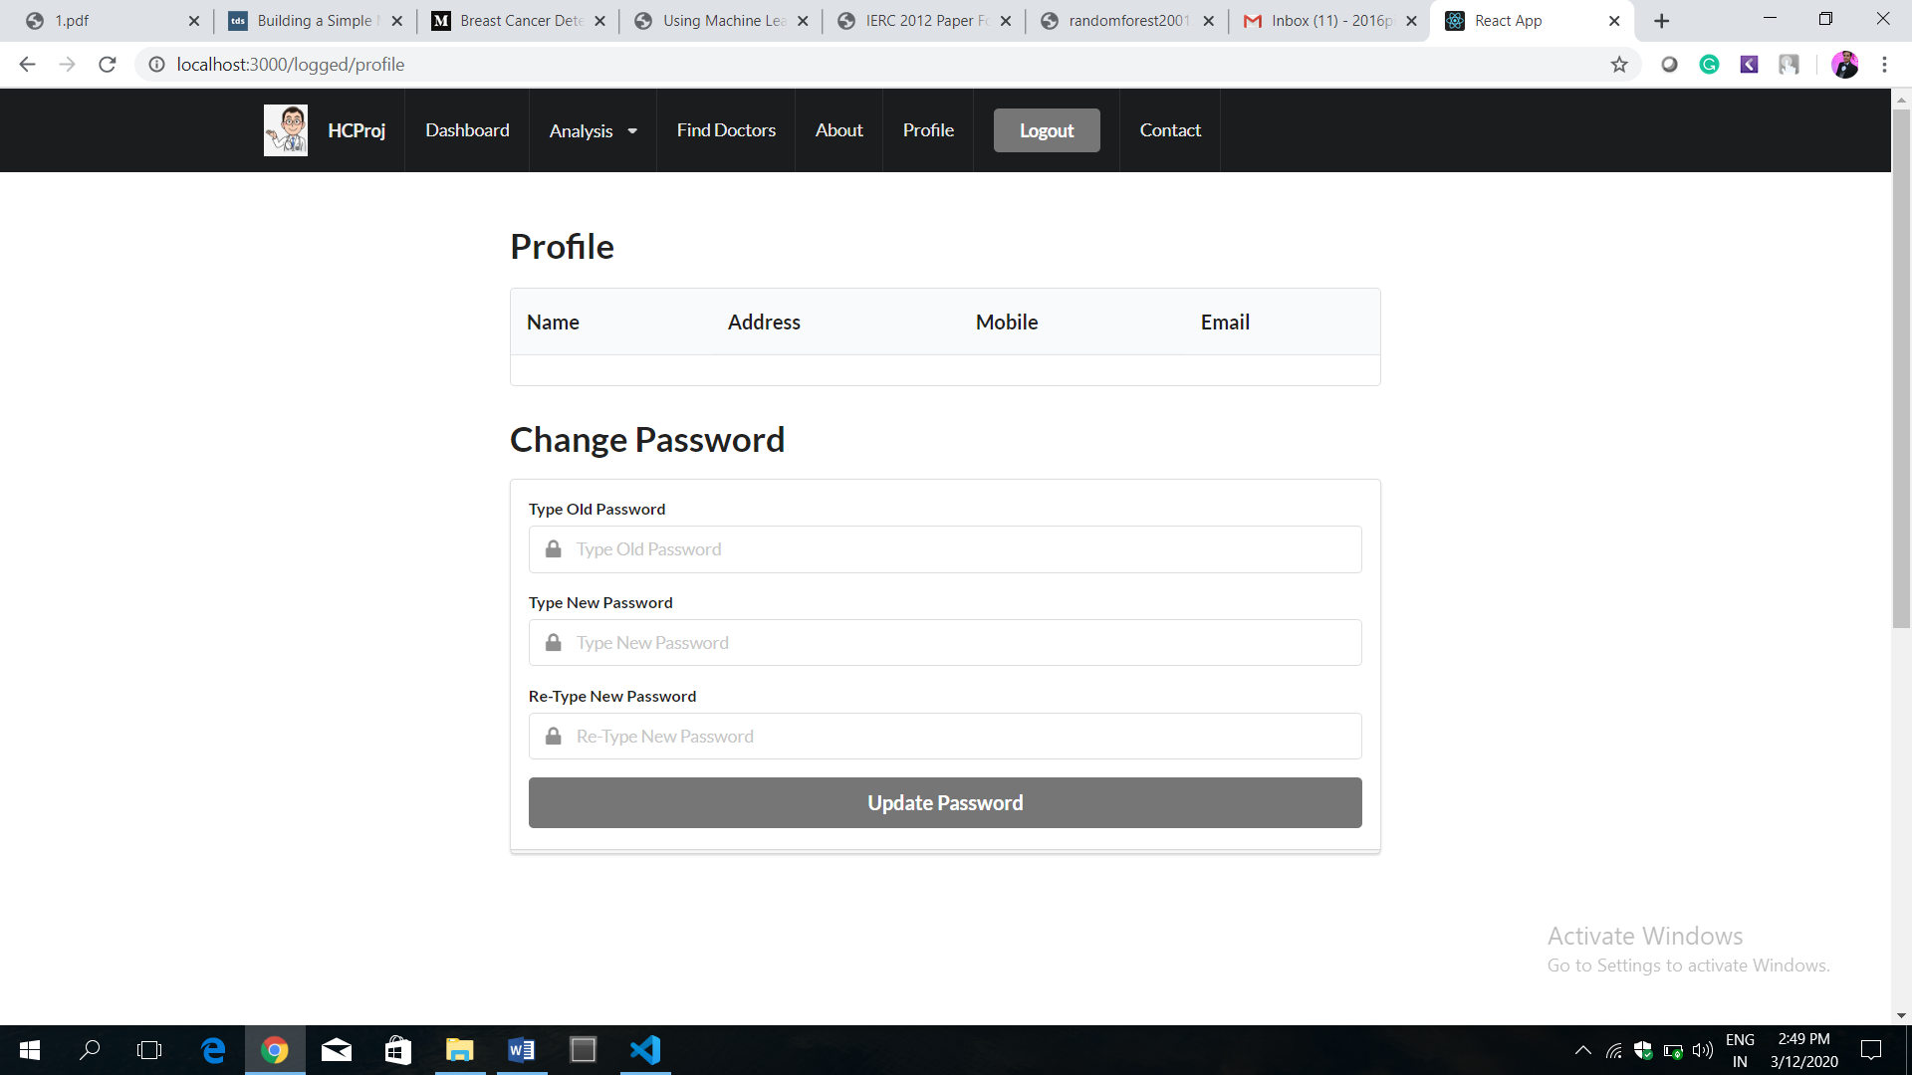
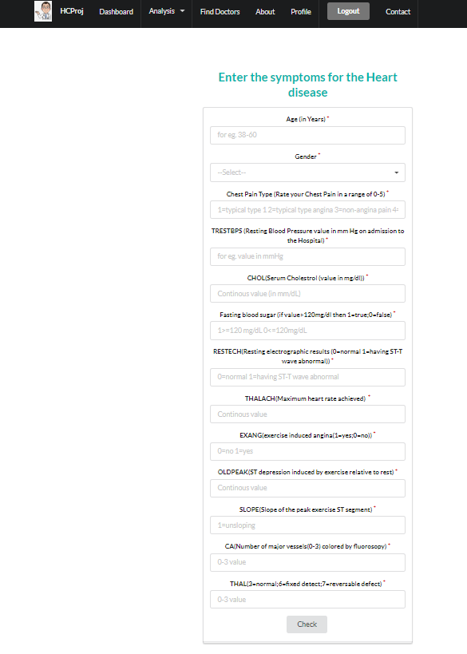

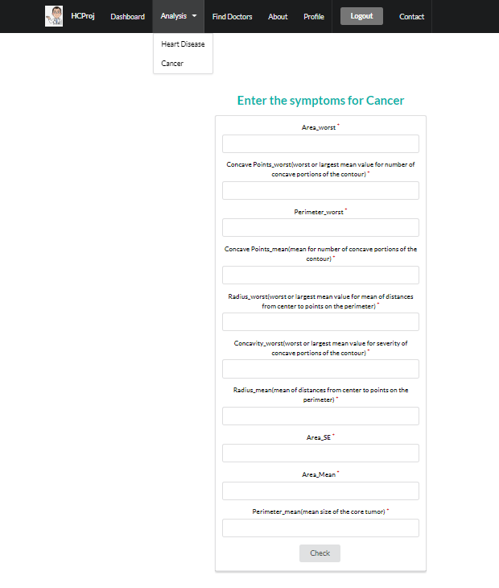
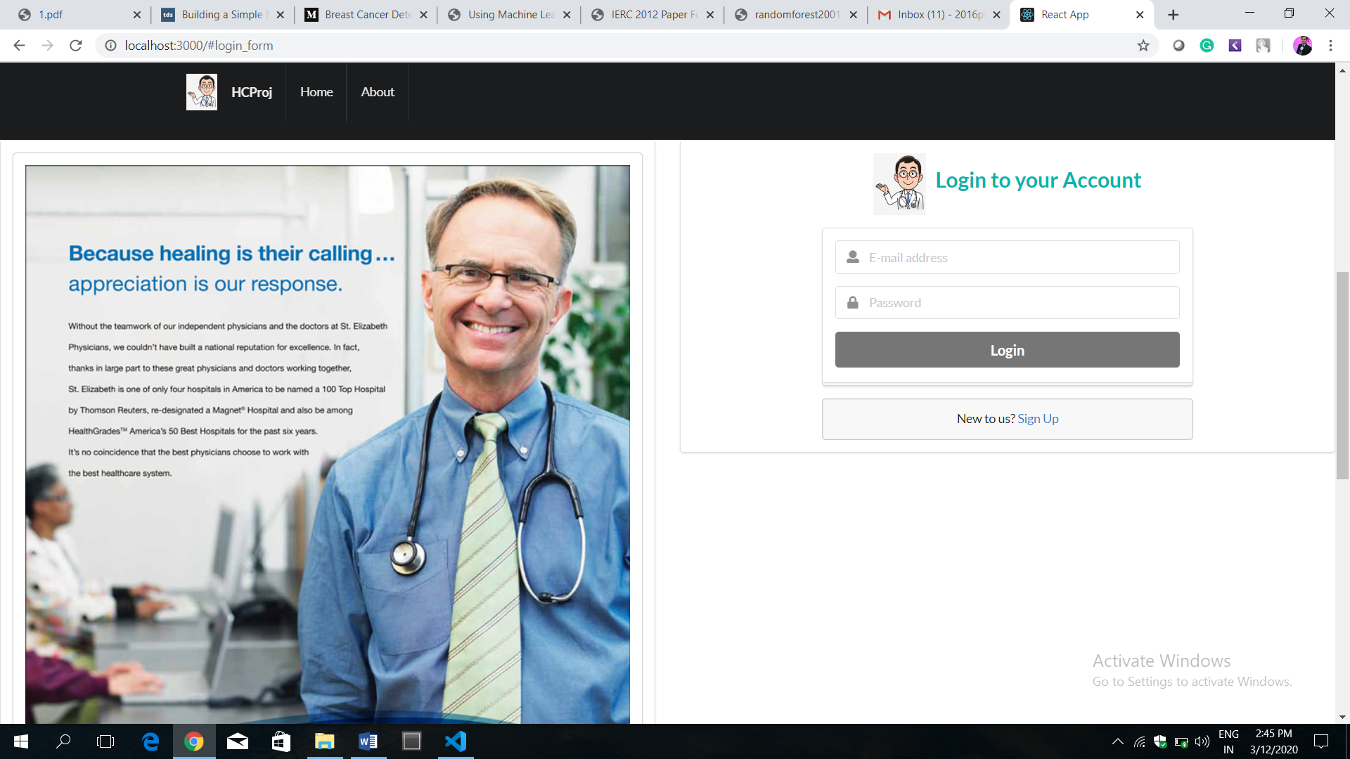
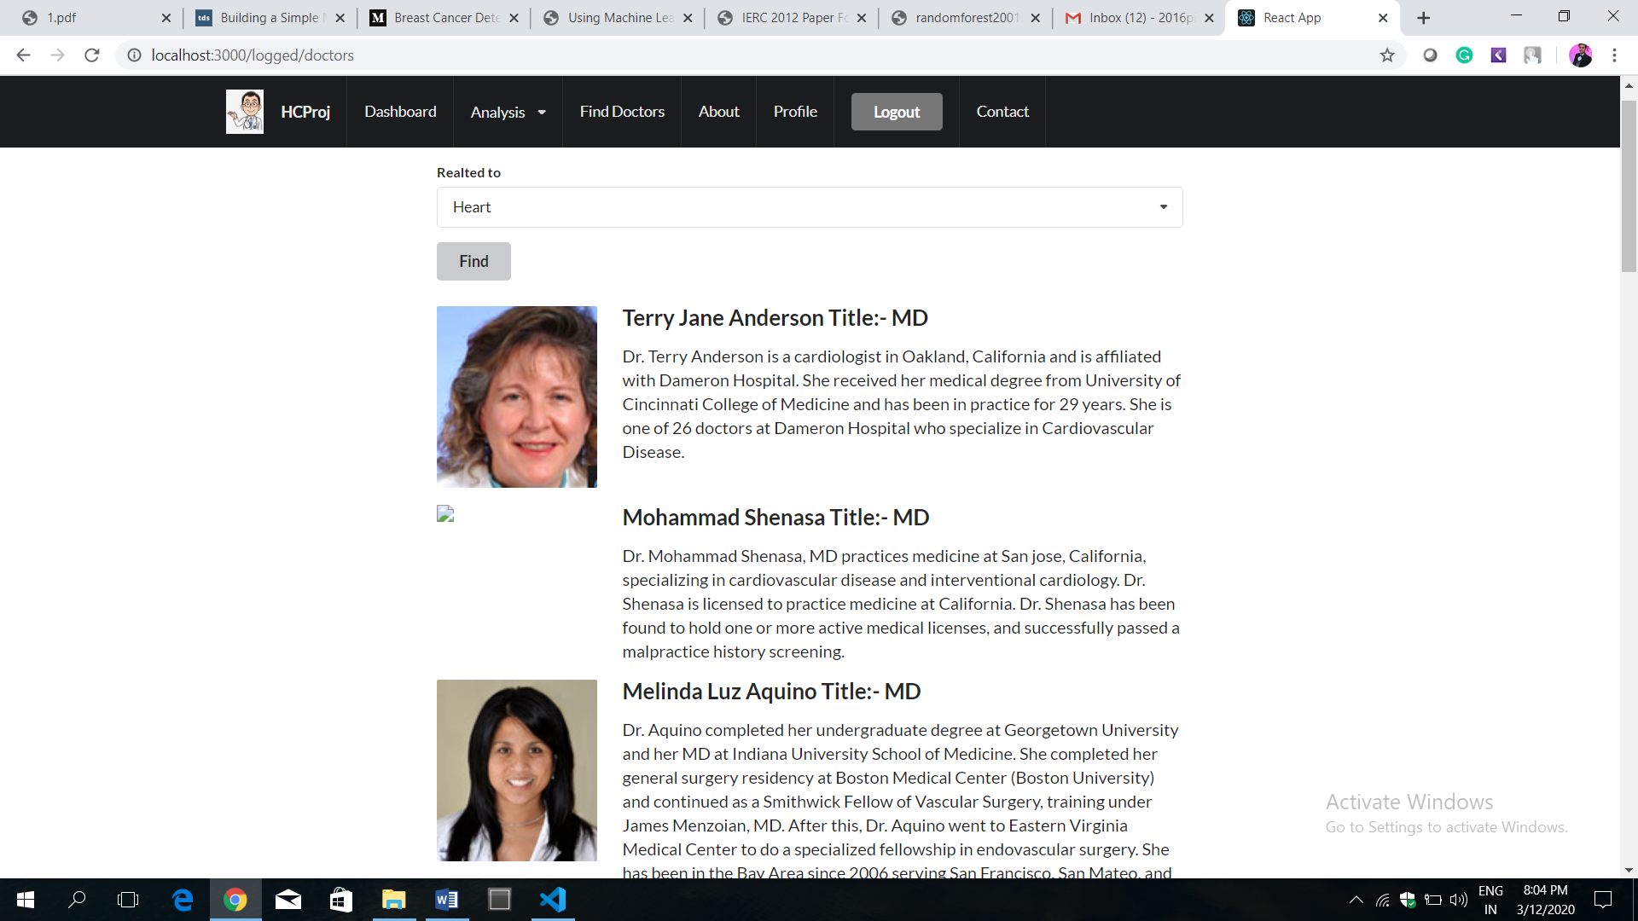
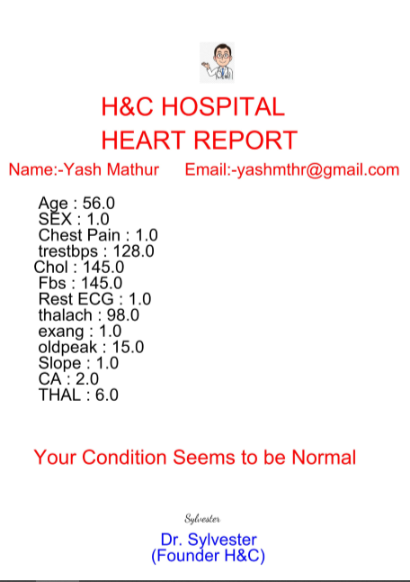
snapshots

Slide 19
conclusion
Our work mainly focused in the advancement of predictive models to achieve good accuracy in predicting valid disease outcomes using supervised machine learning methods.
The analysis of the results signify that the integration of multidimensional data along with different classification, feature selection and dimensionality reduction techniques can provide auspicious tools for inference in this domain.
We were able to predict the accuracy of Breast Cancer using Supervised Machine Learning Techniques approximately 95 percent.
Benefits to the society:
Thus we proposed that integration of clinical decision support with computer based patient records could reduce medical errors, enhance patient safety, decrease unwanted practice variation, and improve patient outcome.
The main objective of this research is to develop a prototype Intelligent system using various data mining and machine learning techniques.
So its providing effective treatments, it also helps to reduce treatment costs. To enhance visualization and ease of interpretation.
With the help of our system we can put an end to medical misdiagnosis.

Slide 20
THANK YOU

